Slide 1

Threads 1: Introduction and Basic Management

Slide 2
Overview
Motivation & Concurrency
Thread abstraction
Thread creation and termination

Slide 3
Motivation
Processes for concurrency
Processes do run concurrently on an O.S.
On multi-core or single-core processors, through time-sharing
Processes also provide protection

Slide 4
Each processes has its own virtual address space
HIGH
Page Tables
Virtual address space 1
High
Physical
Memory
Low
Virtual address space 2
High
LOW
Low
Disk

Slide 5

Each process lives alone in its own castle

Slide 6
Why?
Well…
Nobody can interfere
Nobody can move her “stuff”
Nobody can play with her “stuff”
Nobody can break her toys
It is very very safe!

Slide 7
Downsides ?
Nobody to play with
You can get bored quite quickly
Nobody to do your chores
Do everything yourself!
You can’t leave the castle…
It is also your prison
Communication with the outside is tricky and very limited (but safe)
Banging on a pipe…
Smoke signals…
Sockets…

Slide 8
Where are her buddies (e.g., processes)?
In other castles!
Equally alone / isolated
You cannot get together easily
Sharing is limited

Slide 9
Downsides ?
What if the princess has a lot to do?
Nobody to do her chores
Do everything herself!
Communication with the other princess is tricky and very limited (but safe)
Banging on a pipe…
Smoking signals…
Sockets…
Notes:
And also expensive.

Slide 10
Threads ?
Inviting other “living creatures” inside your castle
These “creatures” can:
Move around independently of you
Do work / chores on your behalf
Communicate on your behalf
Play with you
Use/share your toys
…
Essentially
No limits on their abilities in the address space
As powerful as the “Lord of the Castle”

Slide 11
Refining our definitions
Process is a bundle grouping
A virtual address space [memory]
A collection of files / sockets [IO]
A collection of concurrent threads [execution units]
Thread is a light-weight entity
Can run concurrently with other threads
Share resources in the process [having same rights]
Confined to a single process [cannot “move” to another]
Can be created and destroyed [different life cycles]
Light-weight 'processes' that share the address space (and other resources) in a process
Notes:
Life-cycle distinct from process

Slide 12
The Circle of Life
How is a thread created?
By another thread! pthread_create()
It is given a stack to execute and a function to run
What about the first thread?
When a process is created, there is a single thread [starts alone]
How does a thread die?
Voluntarily, after completing its task pthread_exit()
Requested by another thread pthread_cancel()
When the process dies (along with all threads in it)
Any thread calls exit()
Note that exit() is called when main() returns !
Any thread can bring down the whole castle!

Slide 13
The pthreads API
ANSI/IEEE POSIX 1003.1 - 1995 standard
Three types of routines:
Thread management: create, terminate, join, and detach
Mutexes: mutual exclusion, creating, destroying, locking, and unlocking mutexes
Condition variables: event driven synchronization

Slide 14
The Pthreads API naming convention
Routine Prefix | Function
pthread_ | General pthread
pthread_attr_ | Thread attributes
pthread_mutex_ | mutex
pthread_mutexattr | Mutex attributes
pthread_cond_ | Condition variables
pthread_condattr | Conditional variable attributes
pthread_key_ | Thread specific data keys

Slide 15
The Pthreads API
# include <pthread.h>
Add ' -pthread' option to compile on Linux
cc -pthread a.c
Pthread functions do not set errno on errors
Many types are defined in pthread library. They are opaque objects
Cannot make assumptions on the representation/implementation
For example, should use pthread_equal() to compare two thread IDs

Slide 16
main() function of thread
void * thread_main(void * arg)
The "main" function of a thread
Can be any name you like
Takes a pointer as the only parameter
It can point to anything, int, char, string, or a structure
Returns a pointer
It can point to anything, int, char, string, and a structure
However, do not point to local variables on stack

Slide 17
Threads creation
int pthread_create( pthread_t* thread, pthread_attr_t* attr, void* (*start_routine)(void*), void* arg);
Returns 0 if successful, and non-zero (> 0) if error
*thread is the returned thread ID, if successful
attr specifies the attribute for the thread. NULL for default.
start_routine() is the 'main' function of the thread
void * arg is passed to start_routine()
Thread equivalent of fork(), but it does create (not "clone")

Slide 18
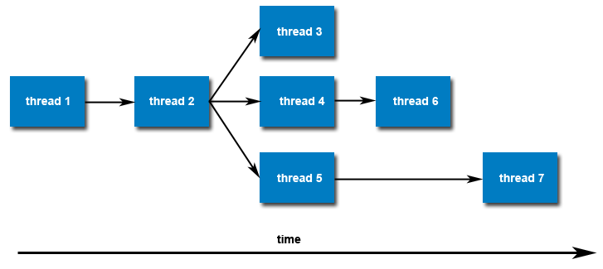
Threads creation
Once created, threads are peers, and may create other threads
There is no implied hierarchy or dependency between threads
All threads are equal!

Slide 19
What about thread concurrency?
Single-core CPU: Timesharing
When one thread is waiting for an IO to complete…
… another thread can use the CPU for some computing
At any one point in time, CPU is used by only ONE thread

Slide 20
What about thread concurrency?
Multi core CPU: true concurrency
MIMD architecture: multiple instructions, multiple data
Threads can execute in parallel, one on each core
OS can still preempt threads
Useful when #threads >> #cores ➔ timesharing is still used!
Core 1
Core 2

Slide 21
Thread Termination
Return from the start_routine function, or
Call pthread_exit()
void pthread_exit(void* status)
The function always succeeds and does not return
status can be obtained by other threads
Similar to process termination
main() returns, or exit() called by any thread

Slide 22
Joining a thread
int pthread_join(pthread_t tid, void** status)
Wait for a thread to complete
Blocks the calling thread until thread tid terminates
Can obtain the exit status of the thread
Pass NULL to ignore the return value
Why is the type of status (void **)?
Equivalent of waitpid()for processes
Notes:
the target specifies in pthread_exit()

Slide 23
Joining a thread - 2
Joining is a simple way to accomplish synchronization
The calling thread can obtain the target thread's termination return status if it was specified in the target thread's call to pthread_exit()
Master Thread
pthread_create()
pthread_join()
p…_join()
Worker Thread
work()
pthread_exit()
Worker Thread
work()
p…_exit()

Slide 24
Question
What happens if main() returns?
Only one thread, where main(), terminates. 10 threads are running
The process terminates. All threads are terminated.
int main(void)
{
// create 10 threads
return 0;
}

Slide 25
Reading
Book “Programming With POSIX Threads”
Chapters 1, 2, 3, 4
Chapter 5, Sections 1 – 4
Nice to read too
Chapter 6, Sections 1 – 5
Chapter 8 [debugging]
Chapter 9 [reference]

Slide 26
Study the remaining slides yourself

Slide 27
Passing Arguments and Getting Results Back
#include <pthread.h>
#include <stdio.h>
#include <stdlib.h>
#include <unistd.h>
#include <string.h>
#define NUM_THREADS 8
struct thread_data
{
int thread_num;
char* message;
int len;
};
void* PrintHello(void* threadarg)
{
struct thread_data* my_data = (struct thread_data*) threadarg;
sleep(1 + 5*(my_data->thread_num % 2) );
my_data->len = strlen(my_data->message);
printf("Thread #%d: %s length=%d\n", my_data->thread_num, my_data->message,
my_data->len);
pthread_exit(NULL);
}

Slide 28
Passing Arguments and Getting Results Back
int main(int argc, char* argv[])
{
pthread_t threads[NUM_THREADS];
struct thread_data thread_data_array[NUM_THREADS];
char* messages[NUM_THREADS];
int rc, t;
messages[0] = "English: Hello World!";
messages[1] = "French: Bonjour, le monde!";
messages[2] = "Spanish: Hola al mundo";
messages[3] = "Klingon: Nuq neH!";
messages[4] = "German: Guten Tag, Welt!";
messages[5] = "Russian: Zdravstvuyte, mir!";
messages[6] = "Japan: Sekai e konnichiwa!";
messages[7] = "Latin: Orbis, te saluto!";

Slide 29
Passing Arguments and Getting Results Back
for( t=0; t<NUM_THREADS; t++ ) {
thread_data_array[t].thread_num = t;
thread_data_array[t].message = messages[t];
printf("Creating thread #%d\n", t);
rc = pthread_create(&threads[t], NULL, PrintHello, &thread_data_array[t]);
if (rc) {
printf("ERROR; return code from pthread_create() is %d\n", rc);
exit(-1);
}
}
int grand_total = 0;
for( t=0; t<NUM_THREADS; t++ ) {
printf("Joining thread #%d\n", t);
rc = pthread_join( threads[t], NULL );
if( rc ){
printf("ERROR; return code from pthread_join() is %d\n", rc);
exit(-1);
}
grand_total += thread_data_array[t].len;
}
printf("Grand total = %d\n", grand_total);
pthread_exit(NULL);
}

Slide 30
Common ways to use threads
Pipeline
A task is broken into a series of sub-operations, each of which is handled in series, but concurrently, by a different thread (think automobile assembly line)
Manager/worker
A single thread, the manager assigns work to other threads, the workers. The manager handles all input and parcels out work to workers.
Two common forms: static worker pool and dynamic worker pool
Peer
Similar to the manager/worker model, but after the main thread creates other threads, it participates in the work

Slide 31
Applications of threads
Parallel computing
On multi-core machines, threads can be executed at the same time
Overlap CPU work with I/O
While one thread is waiting for an I/O, others can perform CPU work
Asynchronous event handling
E.g., a web server can both transfer data from previous requests and manage the arrival of new requests
Priority/real-time scheduling
Important tasks can be scheduled with higher priority
Computer games
Each thread controls the movement of an object
…

Slide 32
Why is it hard for the princess to do everything by herself?
Imagine an application liked Microsoft Word.
When you are typing, the process needs to
Listen for keystrokes and display the text on screen
Save data periodically to disk so you do not lose data in case of crash
Reformat the document while you edit the text
How can a single process (i.e., one princess) can do all these concurrently?
The answer is she cannot without affecting application performance!

Slide 33
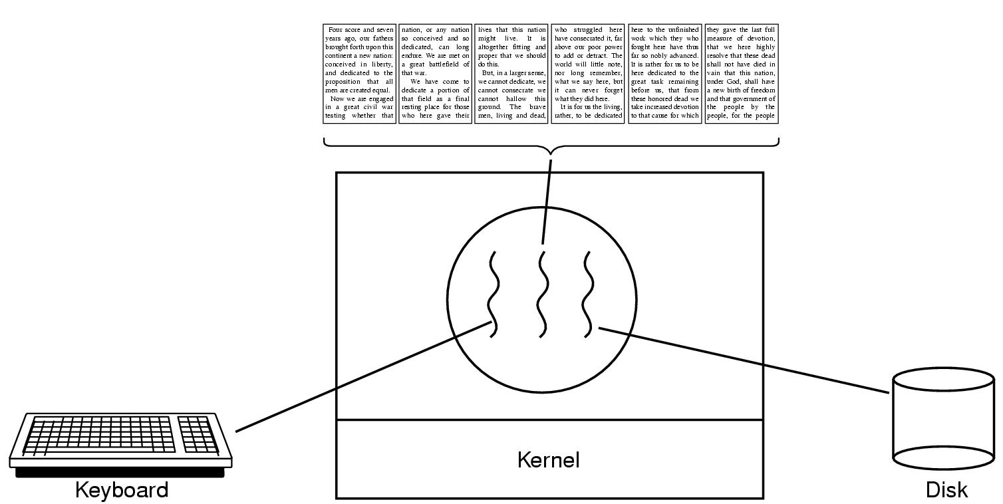
We solve it by creating multiple threads!
A word processor with three threads.

Slide 34
Usage Examples?
We will create multiple threads, one thread for each sub tasks
One thread controls a GUI
One thread reformats the document
One thread does background tasks (e.g., saving!)
Other Examples
Worker threads do parallel computations
e.g., in matrix-vector multiplication: do all the rows in parallel
e.g., simulate agents in parallel [think agents in games!]

Slide 35
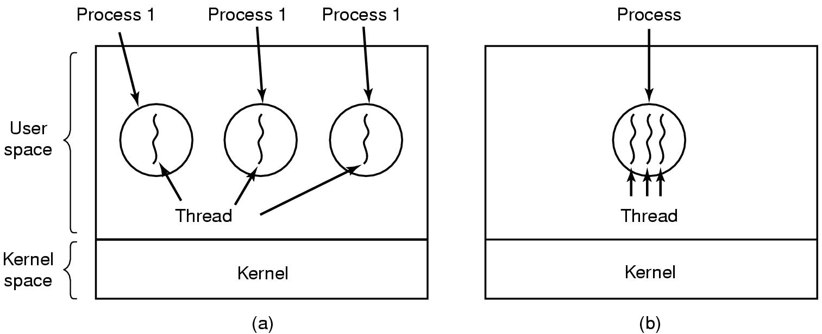
The Classical Thread Model (1)
Three processes each with one thread.
One process with three threads.
Notes:
Process 1, 2, 3,.

Slide 36
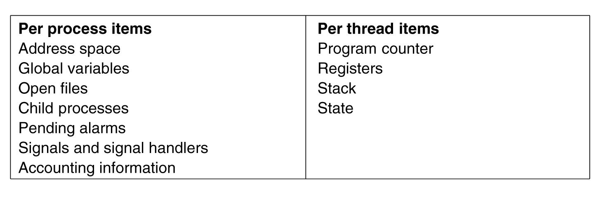
The Classical Thread Model (2)
Shared by all threads in a process.
Private to each thread.

Slide 37
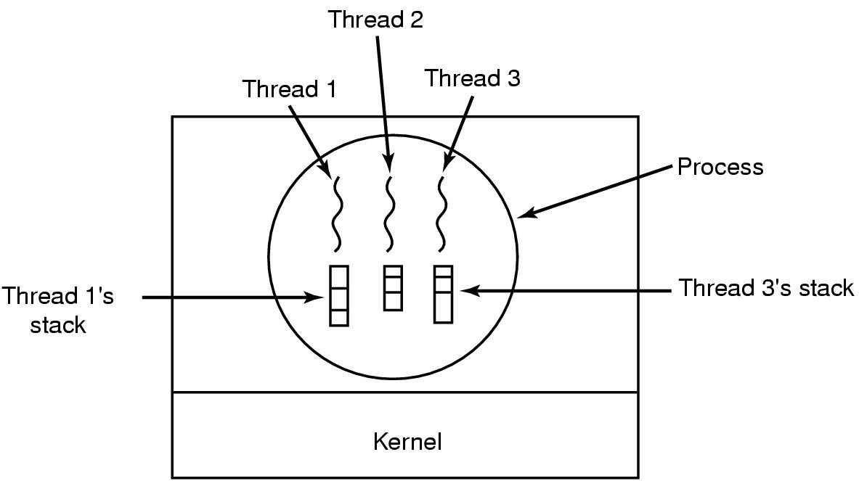
The Classical Thread Model (3)
Each thread has its own stack.

Slide 38
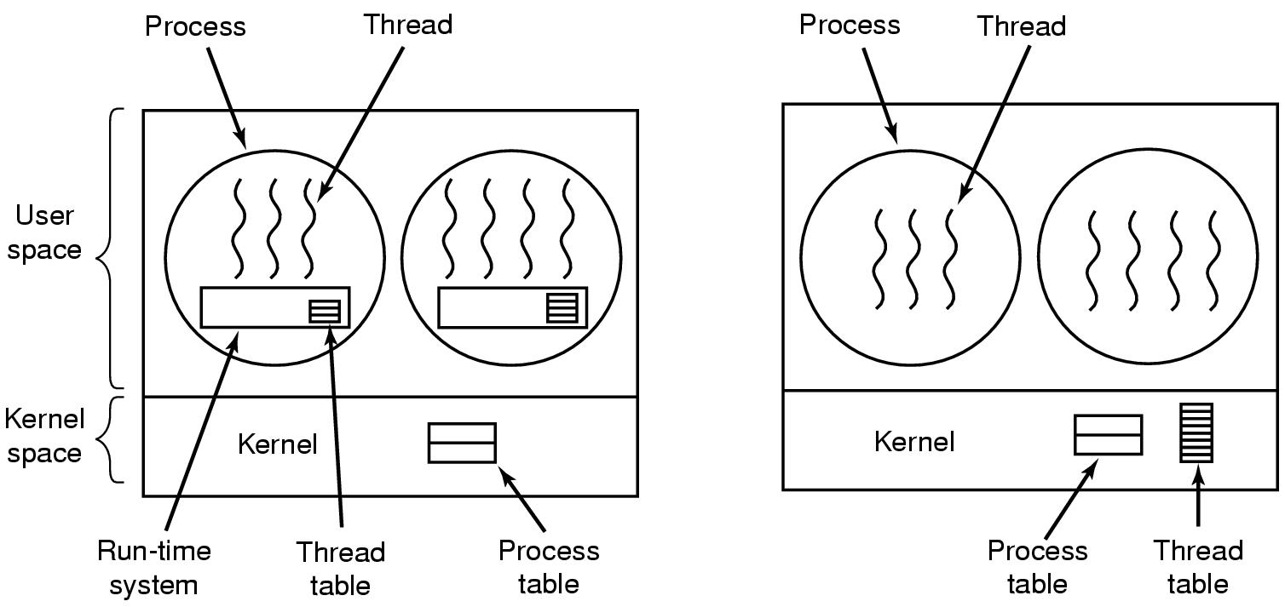
Implementing Threads
A user-level threads package.
A threads package managed by the kernel.

Slide 39
The Plot
What you wish to share (the toy) is
The variable x
It exists somewhere in the shared virtual address space
It has no special status (compared to other memory regions!)
The protagonist who both want to play with the toy are
thread 1
thread 2
x

Slide 40
Your objective
Protect the toy (x)
Make sure nothing “bad” happens to it.
In particular, make sure it has the correct value at the end.
Recall
x exists in memory
So you wish to protect memory (an integer)

Slide 41
Idea
You cannot protect the memory holding “x”
But…
You can specify a protocol for everyone using “x”
If a thread wishes to increase “x”…
It must grab a specific “lock” [lock]
If it has the “lock”, it can do what it wants to x. [critical section]
When done with x it must release the “lock” [unlock]
If it does not have the lock, it must wait
You do not protect x directly.
Instead, you discipline the code that touches x.

Slide 42
Idea 1 Is this slide necessary? - Maifi
Put x in a “mini-prison”
If thread 1 wishes to increment “x”
It must take “x” out of its prison, increment it, and put it back.
If thread 2 wishes to increment “x” and the cell is empty….
It must wait until “x” is back in its cell!
Does this work ? [conceptually]
Does this work ? [practically]

Slide 43
32-bit Implication
Virtual Address Space size on 32-bit OS
Linux: 2G
Windows: 1G
Typical stack size per thread
8 Megs
Memory usage goes to
Executable: ~ 1 to 50 megs
Heap: ~ 1 to 200 megs
Stacks: ~ # threads * 8 → 100 threads yield 800 megs
Total near the limit of the address space size.

Slide 44
Circumventing the limit?
Several “ways” to hop along
Make smaller stacks! [but beware of recursion]
Separate tasks in several process that
Communicate via pipes
Communicate via shared virtual memory
Use a 64-bit OS!
Remember 8 megs = 2²³
Adress space size = 2⁶⁴
Executable space: no more than 1/2 !
What’s left is still 2⁶³
How many stacks can you have?
~2⁴⁰

Slide 45
Threads and MIMD architectures
MIMD =
Multiple
Instructions
Multiple
Data
Processor has
Multiple execution units
All executing independently
All executing different instructions
All operating on different pieces of data

Slide 46
Threads and MIMD architectures
Threads
Are OS abstractions that capture computation streams
Can be scheduled on a MIMD processor
All concurrent threads execute different instructions on different data

Slide 47
Timesharing
Idea is simple
Different pattern of interaction [work / IO] for threads
When one thread is “waiting” for an IO to complete….
… another thread can use the CPU for some computing.
At any one point in time, CPU is used by only ONE thread
True concurrency
There are > 1 CPUs
Threads are executing truly in parallel, one on each CPU
OS can still preempt threads
Useful when # threads >> # cpus! → time sharing is also used!

Slide 48
Threads ?
Definition [wikipedia]
Euh?
In computer science, a thread of execution is the smallest sequence of programmed instructions that can be managed independently by a scheduler (typically as part of an operating system).
This slide is confusing. - Maifi

Slide 49
Threads (Take 2)
Inviting other “living creatures” agents inside your castle
These “creatures” can:
Move around independently of you
Do work / chores on your behalf
Communicate on your behalf
Play with you
Use/Share your toys
…
Essentially
No limits on their abilities in the address space
As powerful as the “Lord of the Castle”

Slide 50
User Level Thread
Can be implemented on top of OS that does not support threading
Each process maintains thread table
Per process run time system for thread switching
Each process can have its own customized algorithm

Slide 51
User Level Thread
But
Blocking system call in one thread can be a problem
Change all blocking to non-blocking call by changing OS
Within a single process, there is no interrupt. If a thread does not give up voluntarily, other threads in the same process will not get a chance
Threads are mainly for processes that often blocks for I/O
User level thread does not make much sense as the goal was to avoid expensive kernel switch. Once switch is done, not much work to switch between threads

Slide 52
Kernel Level Thread
Kernel has a thread table for all threads
Holds thread specific registers, stack, state
Thread recycling
Instead of deleting thread data structure, preserve it and reuse it
But
What happens when multithreaded process forks?
Signals are per process. Which thread should receive the signal?

Slide 53
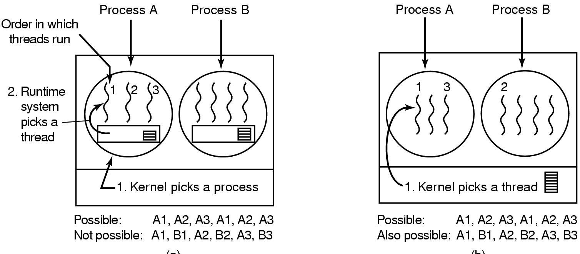
Lets check …

Slide 54
Threads and Castles
In reality
When a process is created there is only 1 living creature (1 thread)
The first thread is no different from other threads
All threads have equal rights (unless otherwise specified)

Slide 55
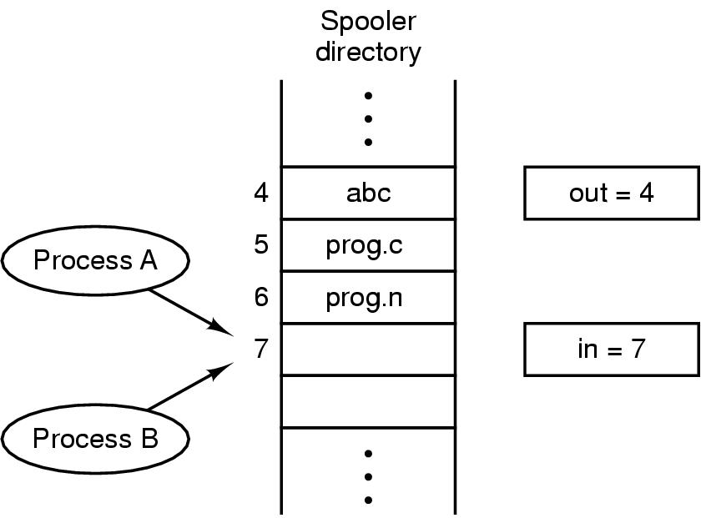
Race Conditions
Two processes want to access shared memory at the same time.

Slide 56
Critical Regions (1)
Conditions required to avoid race condition:
No two threads may be simultaneously inside their critical regions.
No assumptions may be made about speeds or the number of CPUs.
No threads running outside its critical region may block other processes.
No threads should have to wait forever to enter its critical region.

Slide 57
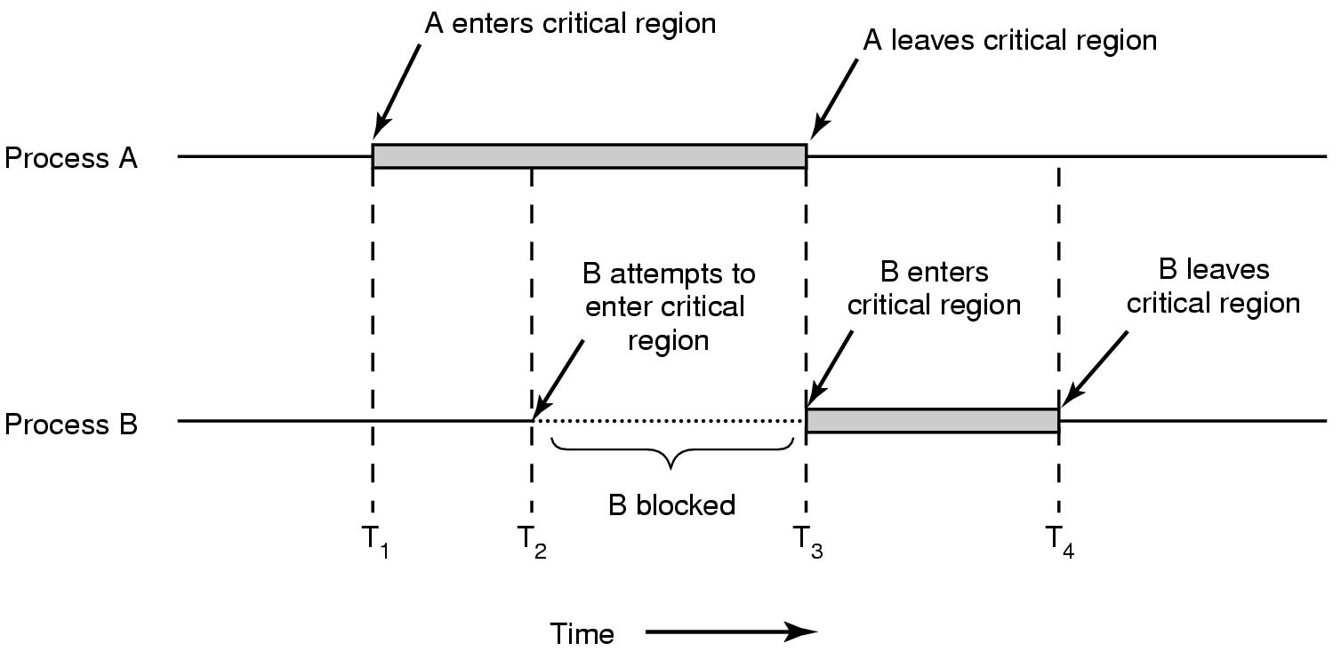
Critical Regions (2)
Mutual exclusion using critical regions.

